Slide 1
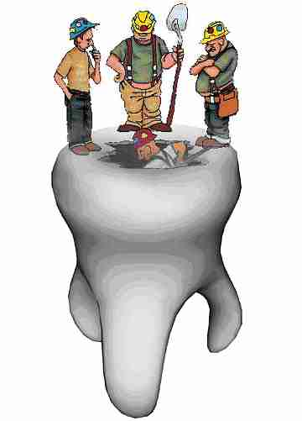
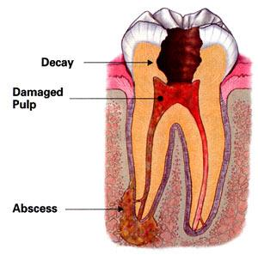
PEDIATRIC ENDODONTICS
Presented by:
Dr. Rajeev Kumar Singh

Slide 2
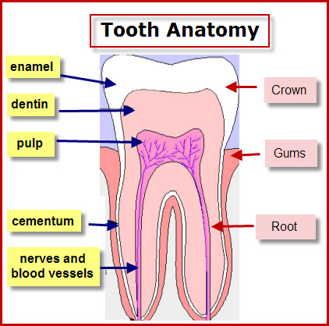

Slide 3
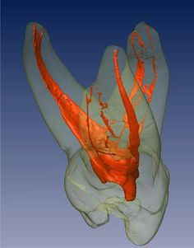
Dental Pulp
The Pulp is a soft mesenchymal connective tissue that occupies pulp cavity in the central part of the teeth.

Slide 4
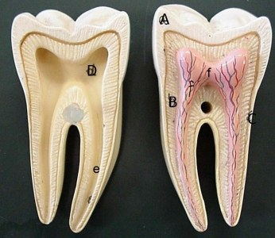
Pulp Cavity
The entire space occupied by pulp, composed of the pulp chamber and root canal
Pulp chamber
Root canal

Slide 5
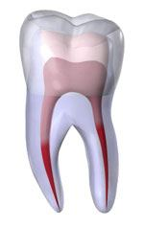
Dental Pulp
The pulp cavity is divided into:
Coronal pulp
2. Radicular pulp

Slide 6
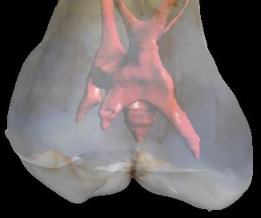
Coronal Pulp
It is the pulp occupying the pulp chamber of the crown of the tooth
In young teeth, it resembles the shape of the outer dentin
It has six surfaces: occlusal, mesial, distal, buccal, lingual and floor.
Pulp horns are projections into the cusp.
This pulp constricts at the cervical region where it continues as the radicular pulp
Pulp horns

Slide 7
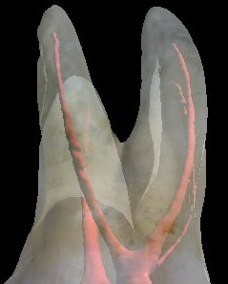
Radicular Pulp
It is the pulp occupying the pulp canals of the root of the tooth
In the anterior tooth it is single and in the posterior teeth it is multiple
The radicular portions of the pulp is continuous with the periapical tissues through apical foramen
As age advances the width of the radicular pulp is reduced.

Slide 8
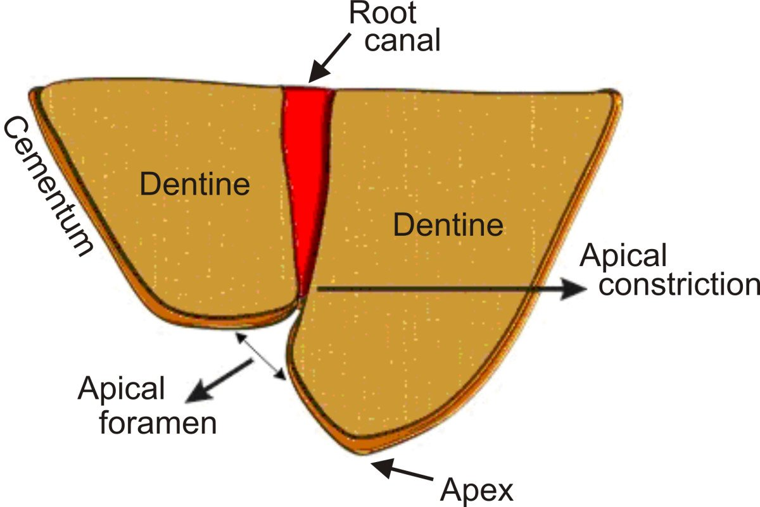
Apical Foramen
Pulp cavity terminates at root apex as small opening called apical foramen
Radicular pulp continuous with connective tissue of the periodontium through this foramen.
Wide open during development of root

Slide 9
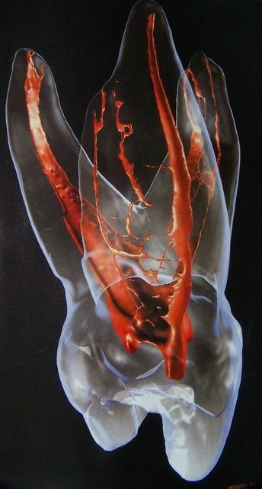
Accessory Canals
Leading laterally from the radicular pulp into the periodontal tissue.
Present in the apical third of the root sheath cells
May also be present at the furcation region

Slide 10
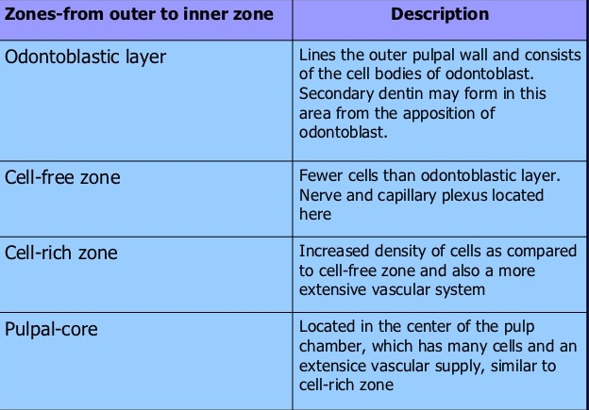
(Zone of Weil)
Histological zones of pulp

Slide 11
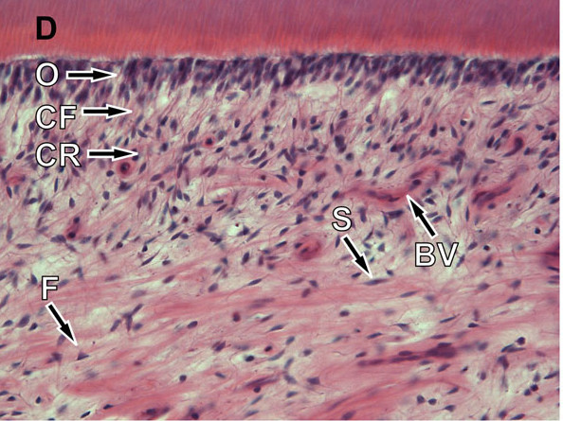
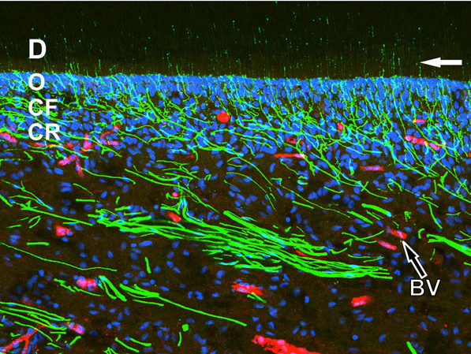
Histological zones of pulp
Confocal micrograph
Light micrograph

Slide 12
Cells of the pulp
ODONTOBLASTS
FIBROBLASTS
UNDIFFERENTIATED CELLS
DEFENSE CELLS

Slide 13
FUNCTIONS OF DENTAL PULP
Inductive - oral epithelial differentiation
into dental lamina and enamel organ
Formative – dentin formation
Nutritive - maintains the vitality of dentin by
providing O2 and nutrients to the odontoblasts
Defense – responds to irritation by producing reparative
dentin
Protective - recognition of stimuli like heat, cold, pressure
chemicals way of sensory nerve fibers

Slide 14
Pediatric Endodontics
endodontics Greek words endo- "inside" & odont- "tooth"
dental specialty concerned with the study and treatment of the dental pulp in children

Slide 15
Reaction of dental pulp to injuries/caries
Physical/Chemical/Thermal injuries
Dental caries
Pulpal irritation
Inflammation
No treatment
Reversible
Irreversible
Vital pulp therapy
Pulp Necrosis
Repair
Non-vital pulp therapy

Slide 16
PULP THERAPY IN PRIMARY TEETH
Vital pulp therapy
Non-vital pulp therapy
Pulpectomy
Protective liner
Pulp capping
Indirect
Direct
Pulpotomy

Slide 17
PULP THERAPY IN YOUNG PERMANENT TEETH
Vital pulp therapy
Non-vital pulp therapy
Protective liner
Closed apex
Open apex
Apexogenesis
RCT
Apexification
Pulp capping
Pulpotomy

Slide 18
Vital pulp therapy
Defined as a treatment initiated to preserve and maintain pulp tissue in a healthy state
Stimulate the formation of reparative dentin to retain the tooth as a function unit
Dentin bridge formation and continuation of root development are primary goals of vital pulp therapy

Slide 19
Protective liners/base
A protective liner is a thinly-applied liquid placed on the pulpal surface of a deep cavity preparation, covering exposed dentin tubules to act as a protective barrier between the restorative material or cement and the pulp.
Materials Used:
calcium hydroxide
dentin bonding agent
glass ionomer cement

Slide 20
Protective liners/base
Indications:
In a tooth with a normal pulp, when all caries is removed for a restoration, a protective liner may be placed in the deep areas of the preparation to minimize injury to the pulp, promote pulp tissue healing, and/or minimize post-operative sensitivity.

Slide 21
Protective liners/base
Objectives:
The placement of a liner in a deep area of the preparation is utilized to preserve:
tooth’s vitality
promote pulp tissue healing
tertiary dentin formation
minimize bacterial micro leakage

Slide 22
Indirect Pulp Capping (IPC)
Indirect pulp treatment is a procedure performed in a
tooth with a deep carious lesion approximating the pulp but without signs or symptoms of pulp degeneration

Slide 23
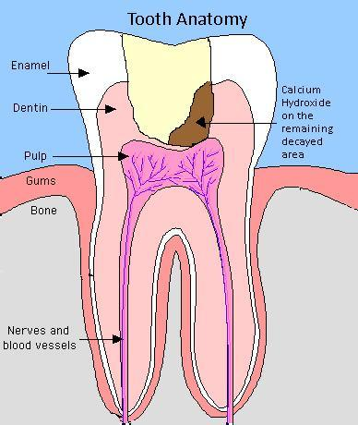
Indirect Pulp Capping
The caries surrounding the pulp is left in place to avoid pulp exposure and is covered with a biocompatible material

Slide 24
Infected Vs affected dentin
Infected dentin
Affected dentin
Superficial layer which is soft and leathery in consistency and dark brown in colour
It has a high concentration of bacteria and collagen is irreversibly denatured
It is not remineralizable and must be removed
Deeper layer which is hard in consistency and light brown in colour.
It does not contain bacteria and is reversibly denatured.
Therefore this layer is preserved

Slide 25
Indirect Pulp Capping
Indications:
Tooth with minimal reversible pulpitis
Signs/symptoms of tooth vitality
Deep caries, which if removed, will cause pulp exposure
Indications:

Slide 26
Indirect Pulp Capping
Contra indications:
Tooth with irreversible pulpitis
Clinical and radiographic signs/symptoms of non vitality of pulp
Soft leathery dentin in a very large area in a non restorable tooth

Slide 27
Indirect Pulp Capping
Materials used:
Calcium hydroxide
Zinc oxide eugenol (ZOE)

Slide 28
Indirect Pulp Capping
Technique:
Two appointment technique
One appointment technique

Slide 29
One Appointment technique -First appointment
Use local anesthesia and isolation with rubber dam ↓
Establish cavity outline with high speed hand piece
↓
Remove the superficial debris and majority of the soft necrotic dentin with slow speed hand piece using large round bur
↓
Soft carious dentin is removed with a sharp spoon excavator
↓
Stop the excavation as soon as the firm resistance of sound dentin is felt
↓
Cavity flushed with saline and dried with cotton pellet
↓
Site is covered with pulp capping agent
↓
Rest of the cavity is filled with reinforced ZOE cement

Slide 30
Second appointment (6-8 weeks later)
Between the appointment history must be negative and temporary restoration
should be intact.
↓
Take a radiograph and observe for sclerotic dentin.
↓
Carefully remove all temporary filling material.
↓
Previous remaining carious dentin will have become dried out, flaky and easily removed.
↓
The area around the potential exposure will appear whitish and may be soft;
which is predentin. Do not disturb this area.
↓
The cavity preparation is washed out and dried gently.
↓
Cover the entire floor with calcium hydroxide.
↓
Base is built up with reinforced ZOE cement or GIC.
↓
Final restoration placed

Slide 31
One Appointment technique
Re‐Entry..is it necessary….?
May not be necessary if the tooth is asymptomatic.
If the tooth is within 2 yrs of exfoliation, re‐entry is not needed.
It depends on the experience of the clinician
If the clinician had left considerable amount of carious dentin, re‐entry is advised.

Slide 32
Indirect Pulp Capping
Complete sealing of the involved dentin from the oral environment.
The tooth’s vitality should be preserved.
No post-treatment signs or symptoms such as sensitivity, pain, or swelling should be evident.
There should be no radiographic evidence of pathologic external or internal root resorption or other pathologic changes.
There should be no harm to the succedaneous tooth.
Objectives:

Slide 33
Indirect Pulp Capping- step wise
excavation
First step
Removal of carious dentin along the dentin-enamel junction (DEJ) and excavation of only the outermost infected dentin, leaving a carious mass over the pulp.
The objective is to change the cariogenic environment in order to decrease the number of bacteria and slow or arrest the caries development.

Slide 34
Second step
The second step is the removal of the remaining caries and placement of a final restoration.
The most common recommendation for the interval between steps is three to six months, allowing sufficient time for the formation of tertiary dentin and a definitive pulpal diagnosis.
Critical to both steps of excavation is the placement of a well-sealed restoration.

Slide 35


